Slide 1
Investor pitch for MORPHFIT
A Shoe that grows with you, Always!

Slide 2
Problem Statement
Current Challenges:
Frequent shoe replacements due to growth or size changes.
High costs for parents and individuals with foot size fluctuations.
Environmental waste from discarded shoes.
Pain Points:
Limited adaptability, inconvenience, and lack of sustainability in the footwear industry.

Slide 3
Solution- Introducing Morphfit
What is Morphfit?
Shoes that adapt to different sizes using innovative stretchable and adjustable materials.
Key Features:
Size adaptability for children, adults, and elderly users.
Sustainable design to reduce waste.
Stylish, affordable, and customizable.

Slide 4
Market Opportunity
Market Size:
Global footwear market projected at $440 billion by 2028.
Growing trends in sustainable and adjustable footwear.
Target Audience:
Kids and Teens (40%)—Rapid growth phases.
Elderly (20%)—Foot swelling and medical needs.
Travelers and Athletes (20%)—Convenience and adaptability.
General Consumers (20%)—Eco-conscious buyers.

Slide 5
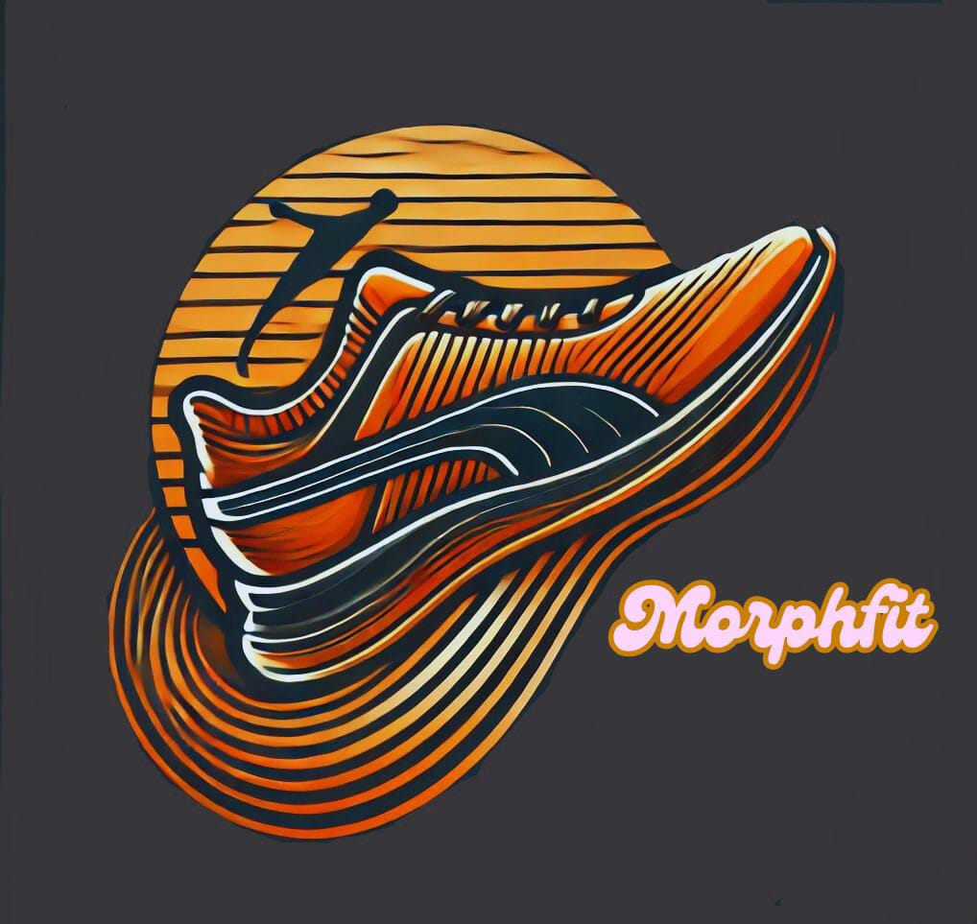
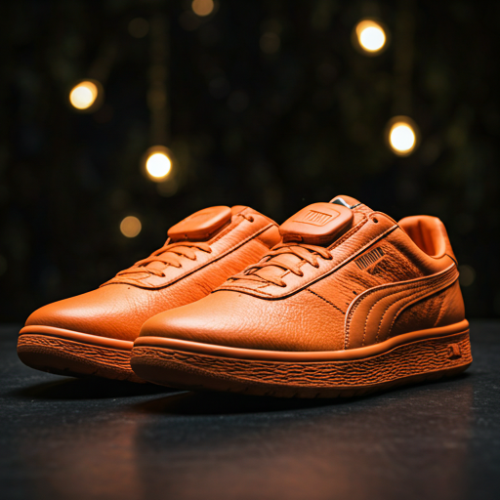
Product Demo

Slide 6
Business Model
Revenue Streams:
Direct Sales: E-commerce platforms and retail partnerships.
Subscription Plans: Growth-based upgrade packages for kids.
Customization Packages: Custom colors, prints, and features.
Pricing Strategy:
Affordable base price with premium customization options.

Slide 7
Go-to-Market Strategy
Launch Plan:
Phase 1: Social media buzz, influencer marketing, and PR campaigns.
Phase 2: Pop-up stores in malls, events, and schools.
Phase 3: Retail partnerships and international expansion.
Marketing Channels:
Social media, SEO, influencer collaborations, and events.

Slide 8
Competitive Analysis
Competitors:
Traditional footwear brands—Nike, Adidas.
Niche sustainable brands—Allbirds, Vessi.
Key Differentiators:
Adjustable sizing, affordability, eco-friendly materials, and subscription plans.

Slide 9
Financial Projections
Year 1 Revenue Target: [$500 million].
5-Year Growth Plan: Expansion to global markets.
Profit Margins: High due to scalable manufacturing.
Investment Ask: [$10000 Amount].
Fund allocation for R&D, marketing, and supply chain optimization.

Slide 10
Team and Expertise
Founder & CEO: Visionary and entrepreneur.
Product Designer: Expert in material engineering.
Marketing Head: Growth strategist with experience in retail.
Advisors: Industry experts and mentors.

Slide 11
Social Impact and Sustainability
Eco-Friendly Approach: Use of sustainable materials.
Environmental Impact: Reduction in landfill waste and carbon footprint.
Corporate Responsibility: Partnership with recycling programs.

Slide 12
Call to Action
Investment Ask: [$100 million]
Why Invest in Morphfit?
Disruptive innovation in footwear.
Growing market demand.
High scalability and profitability.
Contact Details: Email, phone, website, and social links.

Slide 13
Q&A and closing remarks
Open floor for questions
Thank you for your time and interest!!

